Slide 1
Functions
Abu saleh musa miah(abid)
Research student, centre for research & innovation (CRI unit-1)
Signal processing & computational neuroscience laboratory.
Dept. Of computer science and engineering (CSE).
Universtiy of rajshahi.

Slide 2
Functions
Introduction to functions
Types of functions
Elements of user defined functions
Types on the basis of arguments and return values
Methods of calling a function

Slide 3
Introduction to Function
Block of statements that perform the particular task.
Enables modular programming.
Main() is the driver function.
Has pre defined prototype.
Same function can be accessed from different places within a program.
Once a function execution is completed , control return to the place from where the function was called.

Slide 4
Advantages
Modular Programming
Length of source program can be reduced
Easy to locate and isolate faulty function
Functions can be used by other program’s

Slide 5
Types of Functions
Library (Built In) Functions:
They are written in the header files.
To use them appropriate header files should be included.
Header Files | Functions Defined
stdio.h | Printf(), scanf(), getchar(), putchar(), gets(), puts(), fopen(), fclose()
conio.h | Clrscr(), getch()
Ctype.h | Toupper(), tolower(), isalpha()
Math.h | Pow(), sqrt(), cos(), log()
Stdlib.h | Rand(), exit()
String.h | Strlen(), strcpy(), strupr()

Slide 6
User Defined Functions
Written by the user at the time of programming.

Slide 7
Elements of User defined functions
Function Prototype
Function Call
Function arguments and parameters
Function Definitions

Slide 8
Function prototype
It specify the type of value that is to be return from the function and that is to be passed to the function.
It is defined in the beginning before the function call is made.
Syntax:
return-type name-of-function(list of arguments);
Example
Void sum(int, int);

Slide 9
Function Call
A function can be called by specifying name and list of arguments enclosed in parenthesis and separated by comma.
If there is no arguments empty parenthesis are place after function name.
If function return a value, function call is written as assignment statement as:
A=sum(x,y);

Slide 10
Function arguments and parameters
Arguments are also called actual parameters.
Arguments are written within parenthesis at the time of function call.
Parameters are also called formal parameters.
These are written within parenthesis at the time of function definition.

Slide 11
Function Definition
It is the independent program module.
It is written to specify the particular task that is to be performed by the function.
The first line of the function is called function declarator and rest line inside { } is called function body

Slide 12
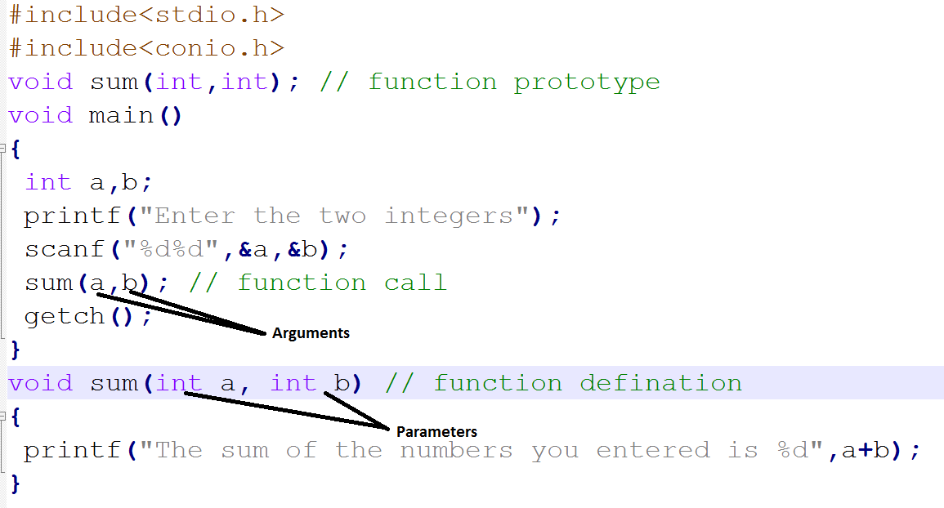

Slide 13
Return statement
It is the last statement of the function that return certain values.
It return certain types of values to the place from where the function was invoked.
Syntax:
return(variable-name or constant);

Slide 14
Categories of function
Function with no arguments and no return
Function with arguments but no return
Function with no arguments and return
Function with arguments and return

Slide 15
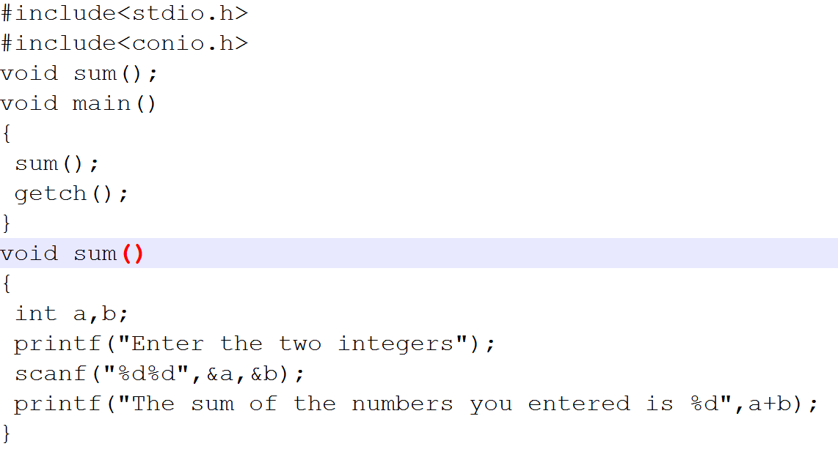
Function with no argument and no return

Slide 16
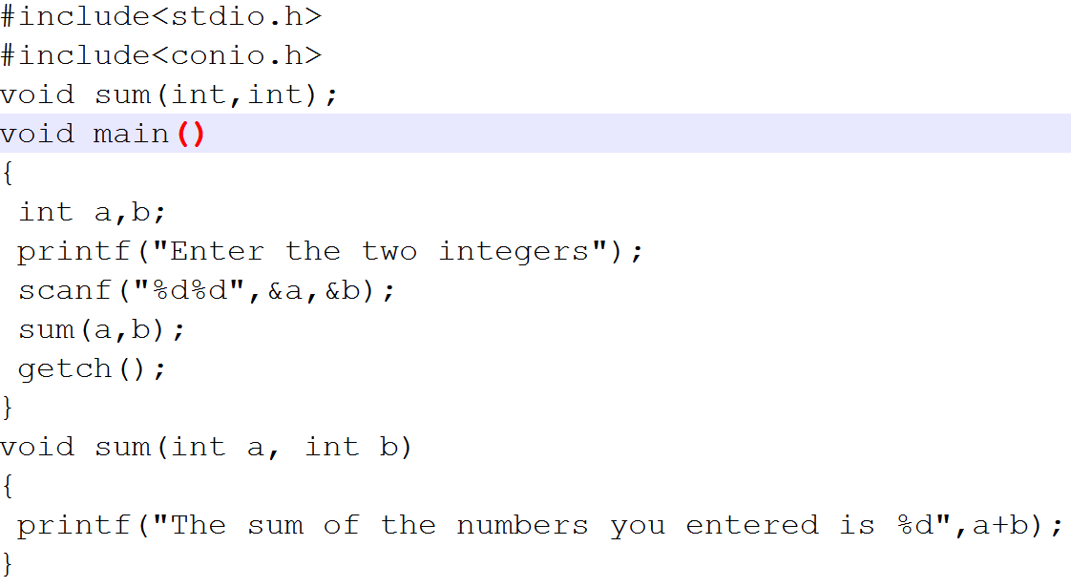
Function with argument and no return

Slide 17
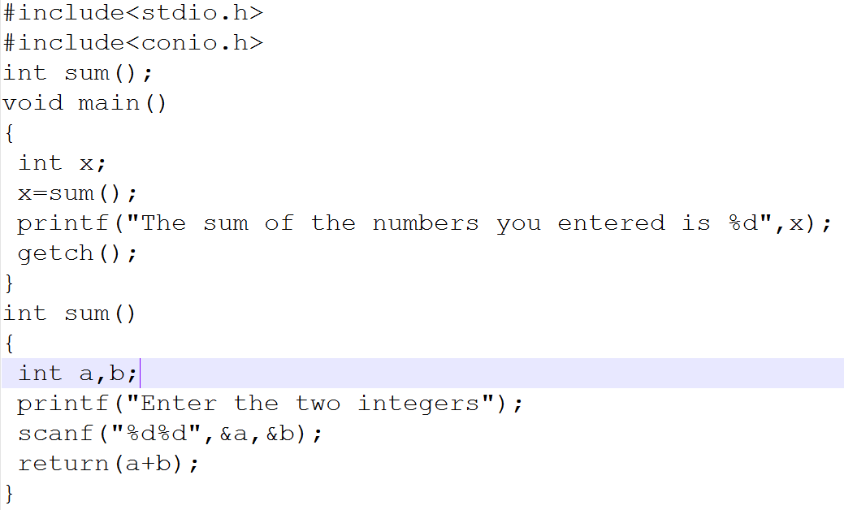
Function with no argument and return

Slide 18
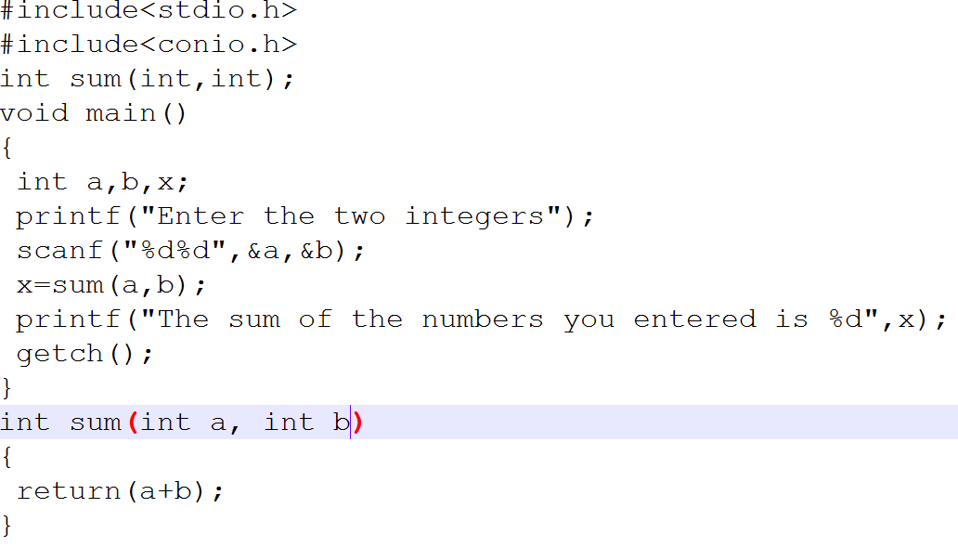
Function with argument and return

Slide 19
Methods of calling function
Call by value
Call by reference

Slide 20
Call by value
Copies the value of actual parameters into formal parameters.
During execution whatever changes are made in the formal parameters are not reflected back in the actual parameters.

Slide 21
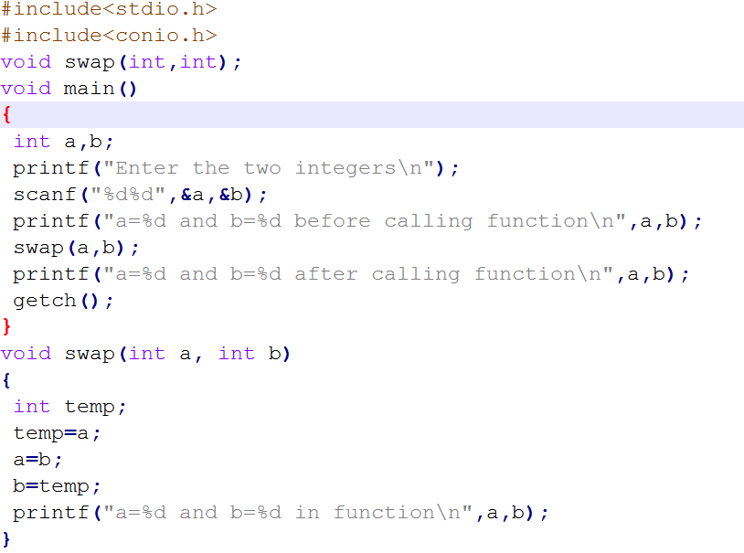

Slide 22
Call by Reference
Reference(address) of the original variable is passed.
Function does not create its own copy, it refers to the original values by reference.
Functions works with the original data and changes are made in the original data.

Slide 23
